Slide 1
EXPLORING HERBAL TREATMENTS: EVIDENCE AND
RECOMMENDATIONS
BY
SHARAIBI, OLUBUNMI J. (PhD)
Department of Botany
Faculty of Science
Lagos State University.

Slide 2
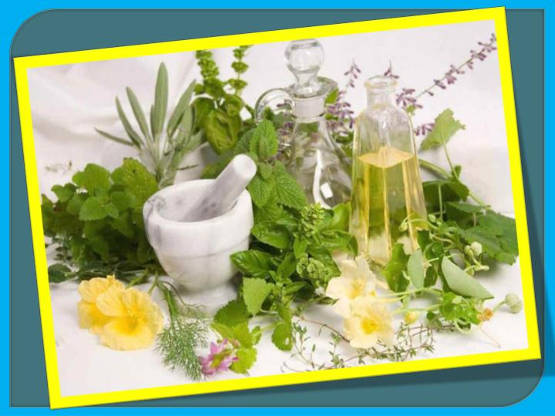
INTRODUCTION
The use of plants for medicinal purposes.
Plants are important not only for food but also for medicine.
They are precursors for the development of new drugs.
All plants contain bioactive substances responsible for their therapeutic actions.

Slide 3
Preparation and Administration of Herbal
Medicine
PREPARATION
Infusion
Decoction
Tinctures
Maceration
Powder
Paste
ADMINISTRATION
Orally
Inhalation
Poultices
Bathing remedies
Topical applications

Slide 4
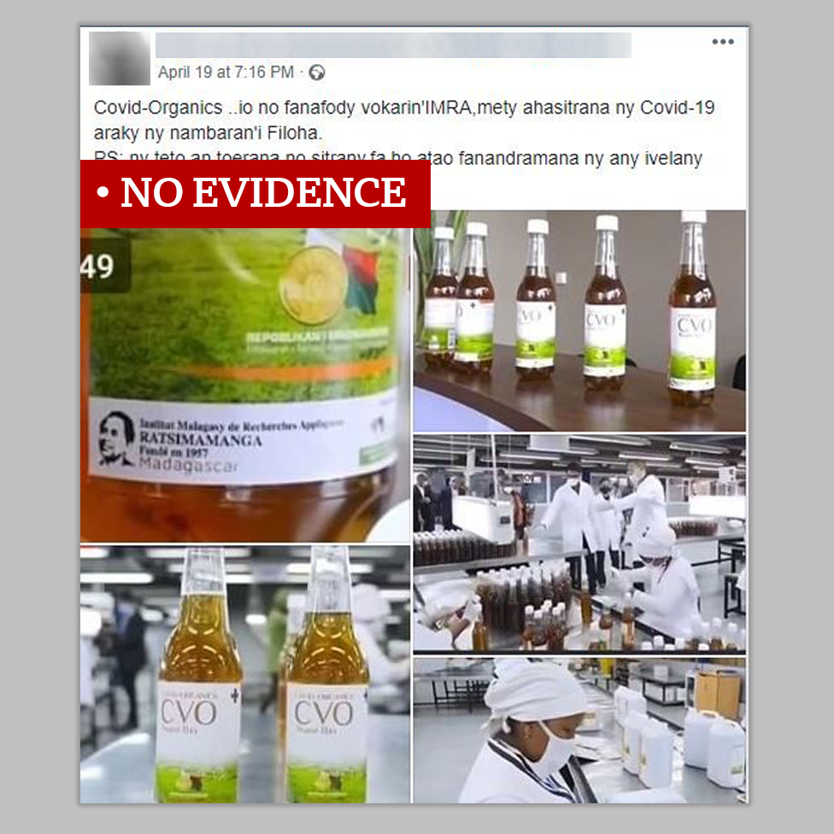
CURRENT EFFORTS?
Development of COVID organics from Artemisia annua.
Identification of anti-SAR-Cov-2 from Traditional Chinese Medicine herbs (Yang et al., 2020).
Nerium oleander, Allium sativum, Thymus vulgaris, Artemisia vulgaris and Allium cepa were reported to act as inhibitors against SARS-CoV-2 main protease (Aanouz et al., 2020).
Prof. Maurice Iwu, Dr. Abalaka etc. herbal mixtures claims.

Slide 5
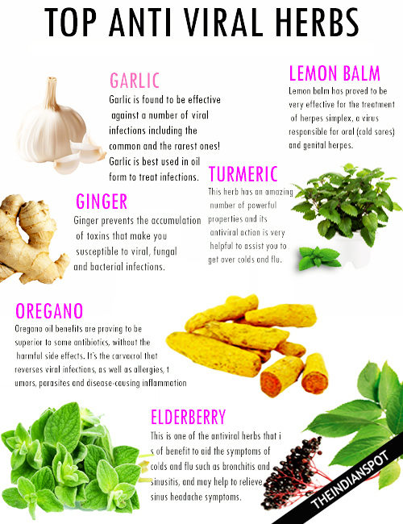
ANTIVIRAL PLANTS
Treatment of infections and viruses, such as the common cold, influenza, fever, measles and even herpes.
Act as immune boosters and help the body to fight infections.
Block certain viruses from replicating in the body.
Rich resource for novel antiviral drugs development

Slide 6
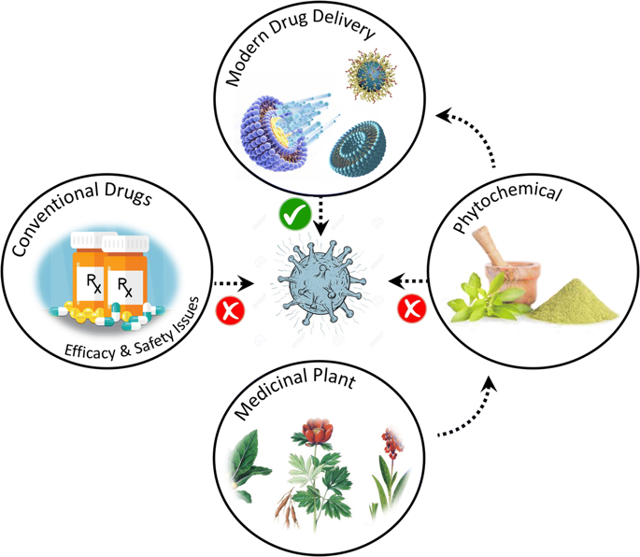
EXAMPLES OF ANTIVIRAL
PLANTS
Lageneria breviflora (Christmas melon)
Cassia fistula (Golden shower)
Phyllantus amarus (Sleeping plant)
Aframomum melegueta (Alligator pepper)
Cymbopogon citratus (Lemon grass)
Garcinia kola (Bitter kola)
Euphorbia hirta (Asthma herb)
Momordica charantia (Bitter apple)

Slide 7
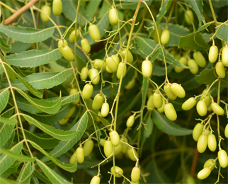
HERBS AS
DETOXIFIERS
AZADIRACHTA INDICA (Neem).
Contains quinine and other alkaloids
Infusion of the leaves is taken as tea.
Roots and shoots decoction can be drank or as bathing remedies.
ALOE BARBADENSIS (Aloe vera)
Contains aloin and emodin.
It has analgesics, antibacterial and antivirals properties.
Its has purgative activity.

Slide 8
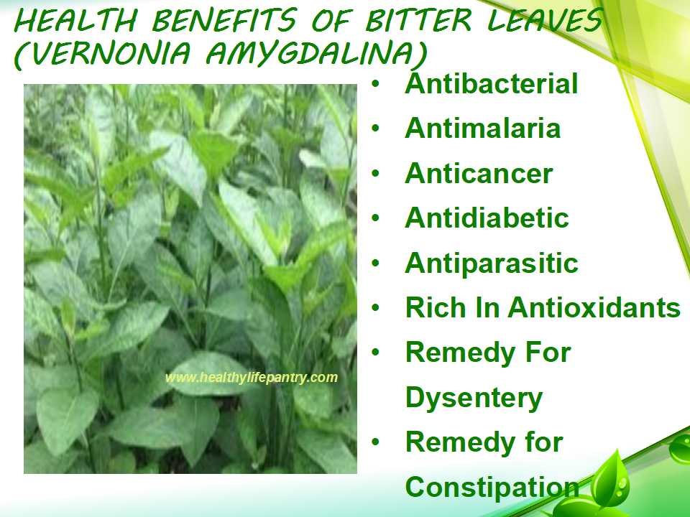
VERNONIA AMYGDALINA
(Bitter Leaf).
Contains steroid glycosides- vernonioside B1
Leaf juice can be squeezed and drank
Leaf can also be cooked as vegetables.
The tincture is very potent against measles,
TETRACARPIDIUM CONOPHORUM (African walnut)
Has high content of phytosterols, omega 3 fatty acids and antioxidants
The nuts are usually eaten as snacks.
The bark is brewed as tea.
The leaf extract offer relief for headache, malaria and fever.

Slide 9
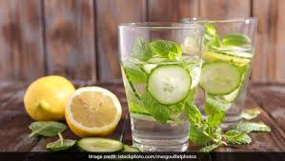
DETOXIFYING HERBAL
DRINKS
Lemon in Warm Water
Ginger + Garlic + Warm Water
Ginger + Cucumber + Lemon + Mint+ Water
Cinnamon +Honey+ Warm Water
Green Tea + Mint
Honey and Lemon
Tumeric + Ginger Tea

Slide 10
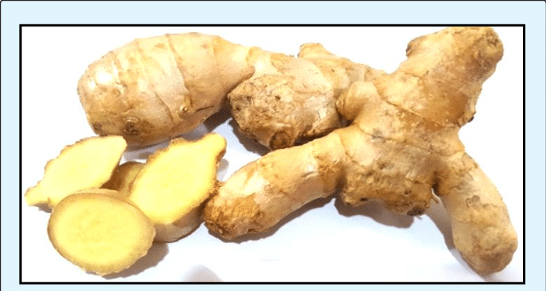
HERBS AS IMMUNE
BOOSTERS
ZINGIBER OFFICINALE ( Ginger).
Contains phenolic compounds, such as gingerols and shogaols which inhibit viral multiplication.
It is taken as a spice or tea to reduce severity of
cough and boost immunity.
ALLIUM SATIVUM (Garlic)
Produces a chemical called allicin.
Exerts an immune-potentiating effect by stimulating natural killer cell activity.
Can be eaten raw or used as spice.

Slide 11
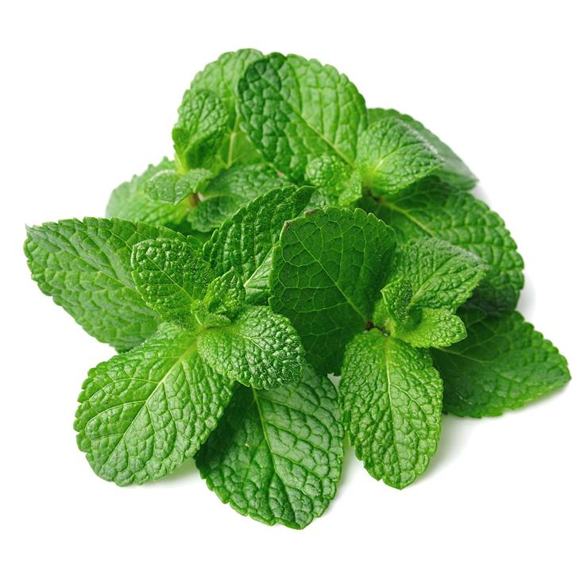
HERBS AS IMMUNE BOOSTERS (CONT’D)
MENTHA PIPERITA (Peppermint)
Contains menthol , methone and limonene
The leaves are taken as a refreshing tea
The oil is used in aromatherapy
CINNAMOMUM ZEYLANICUM (Cinnamon)
Contains cinnamaldehyde, cinnamate and cinnamic acid.
As a spice, it is available in powder form or whole, as pieces of bark.
Rich in antioxidants, antiviral and anticancer properties.

Slide 12
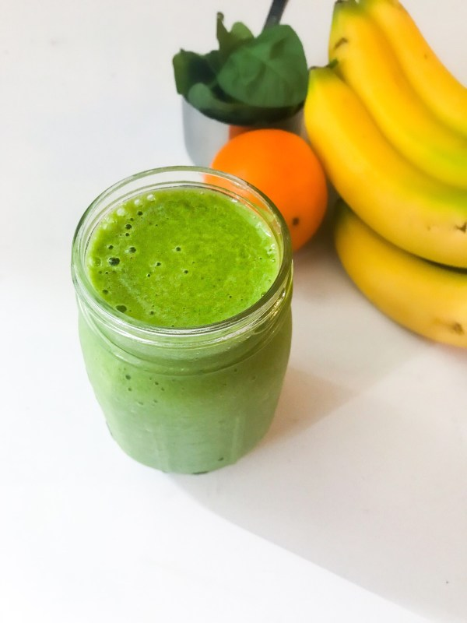
IMMUNE BOOSTING
SMOOTHIES
Cucumber + Avocado + Ginger
Pineapple and Cucumber
Cucumber and Watermelon
Cucumber + Spinach + Ginger
Mango and Pineapple
Banana + Mango + Apple

Slide 13
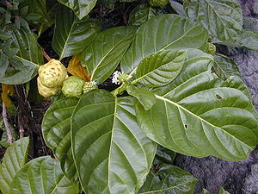
ANTIMALARIAL HERBS
MORINDA LUCIDA (Brimstone Tree).
Contains anthraquinones; rubiadin and morindin.
Decoctions and infusions of the root, bark and leaves are taking as remedies against different types of fever.
The leaf juice is taken to prevent malaria.
The bitter-tasting roots are popular in Nigeria as chewing sticks.

Slide 14
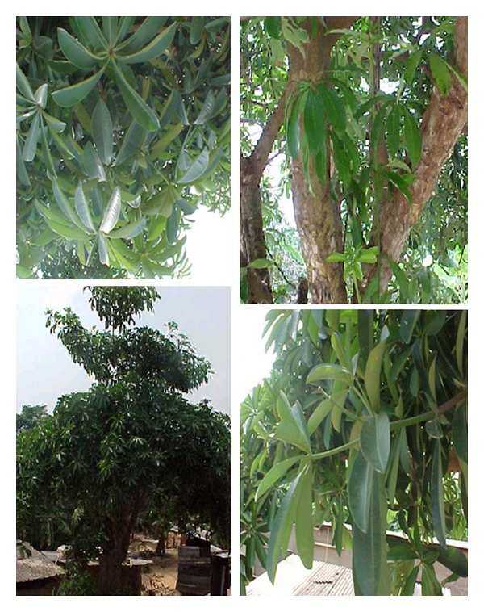
ANTIMALARIAL HERBS
ALSTONIA BOONEI ( God’s Tree).
Contains various bioactive compounds such as echitamidine, boonein, and β-amyrin.
Decoction of the bark and the powder have strong analgesic and anti-malarial properties.
Leaf extracts possess strong antimicrobial activity, hence it is used to treat wounds.
ENANTIA CHLORANTHA (African Whitewood).
Contains alkaloids palmatine, coloumbamine and jatrorrhizine.
It’s used to jaundice, fevers, tuberculosis, bloody vomit and urinary tract infections.
Root and bark decoction is also used as bathing remedies against fever.

Slide 15
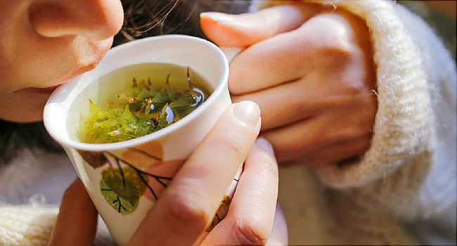
CAUTIONS
Avoid excessive intake of herbal medicine because of toxicity.
Look out for allergic reactions when taking herbal medicines. Discontinue use, if allergy occurs.
If on certain medications, be careful with herbal medicines to prevent drug interactions.
Get your fresh plant materials from trusted source to avoid misidentifications.
If pregnant or breastfeeding, don’t take herbal medicines without your Doctor’s consent.

Slide 16
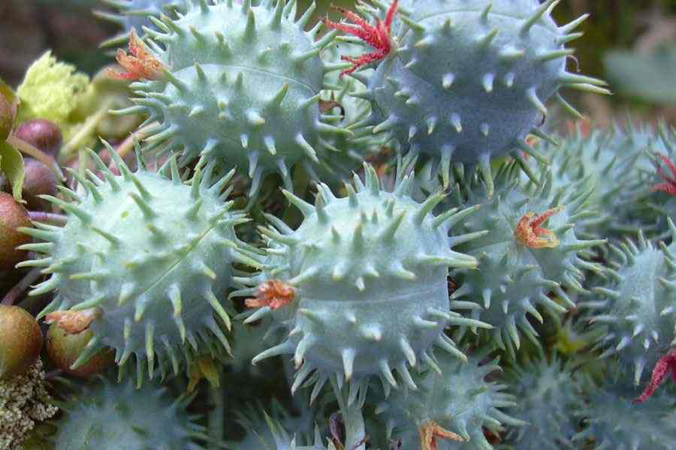
SUGGESTION FOR FURTHER
RESEARCH
RICINUS COMMUNIS (Castor oil plant).
Doctrine of Signature
Contains alkaloids, terpenoids, flavonoids, benzoic acid derivatives, coumarins, tocopherols, terpenoids and fatty acids.
The seed contains ricin- a lectin in the outer coat wchich is highly toxic.
It has strong antimicrobial property.
Castor oil from R. communis has been used for diverse therapeutic purposes.
Further research is needed with collaborations from other Departments.

Slide 17
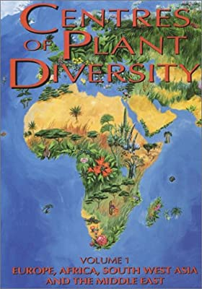
CONCLUSION
Africa, most especially Nigeria is a reservoir of great plant diversity with significant bioactive components that are of high therapeutic activities. COVID-19 pandemic is an avenue for African researchers to show the whole world that solutions can come from Africa through the use of herbs. It is time for African researchers to wake up. This is the time to establish formidable research teams as well as encouraging collaborative researches for us to showcase our heritage to the world.

Slide 18


